Slide 1
The Town of Awendaw Comprehensive Steering Committee Meeting May 25, 2023, 6:00 P.M. AGENDA
Affirmation of Top Ten Guiding Principles
Goals and Strategies Worksheet Review and Comment
Open House Assistance by Steering Committee Members and Staff
Planned Development Regulations Update
Awendaw Tree Canopy Report Outcome
Community Survey Ideas
Date for next Meeting
Adjournment

Slide 2
TEN GUIDING PRINCIPLES FOR AWENDAW’S COMPREHENSIVE PLAN
The Comprehensive Plan is based on ten guiding principles that will protect and enhance the natural beauty and rural lifestyle of the Town. The Comprehensive Plan elements directly support and implement these principles:
1. Community Character. The Awendaw Community is dedicated to preserving, enhancing, and restoring the Town’s character as a rural, coastal, and forest community.
2. Rural Lifestyle. The Awendaw Community recognizes and supports the fishing, wildlife, and forest lifestyles including the historic Gullah/Geechee people of the Town as unique and defining attributes.
3. Natural Environment. The Awendaw Community seeks to preserve, protect, enhance, and restore the Town’s riparian corridors, woodlands, and wetlands to protect its wildlife and natural habitat, and to maintain its scenic bay vistas and tranquil environment.
4. Built Environment. The Awendaw Community believes that the built environment should be subordinate, sensitive, and complementary to the natural environment, setting, and, specific site conditions to minimize disturbance to terrain, conserve visual resources, and protect open space. The Community supports low-country architectural and site design requirements that set forth community expectations and ensure quality development.

Slide 3
TEN GUIDING PRINCIPLES FOR AWENDAWS COMPREHENSIVE PLAN … CONTD.
5. Rural Density. The Awendaw Community strives to avoid the suburbanization of its Town by limiting rural residential density to a maximum of four units per acre in the densest locations on major roadways and then decreasing sharply as you move toward town peripheries. Planned communities will incorporate considerable open space and natural areas into their designs.
6. Circulation. The Awendaw Community promotes safe and convenient circulation for all modes of travel throughout the Town, on Town roads, trails, and paths.
7. Commercial Services The Awendaw Community desires commercial services and facilities which meet the frequently recurring needs of the residents and the occasional needs of highway travelers. The Community feels that a key economic driver for the sustainability of the Town will be eco-tourism and businesses that support this endeavor.
8. Safety. Awendaw strives to protect persons and property from unreasonable exposure to natural hazards, such as hurricane activity, fire, unstable terrain, storms, and flood, by continuously improving regulations, policies, and procedures to reflect current best management practices
9. Community Culture. Awendaw favors a community culture that encourages citizen involvement, individual expression, and diversity, and recognizes the interdependence with neighboring communities and responsibility as good citizens within the region, State, and nation.
10. Sustainability. The Awendaw Community seeks to be a good steward of the land. The goal is to promote the conservation of resources and utilize sustainable practices which recognize the connection to, and interdependence with, the natural environment.

Slide 4
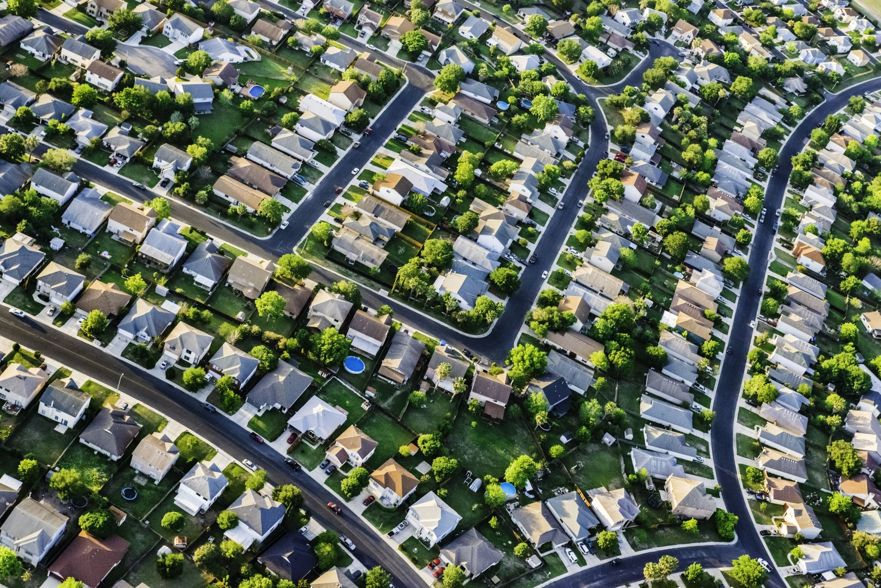
Town of Awendaw Goals and Strategies Worksheet Review…

Slide 5
Community Character …
The Awendaw Community is dedicated to preserving, enhancing, and restoring the Town’s character as a rural, coastal, and forest community.

Slide 6
Community Character…

Slide 8
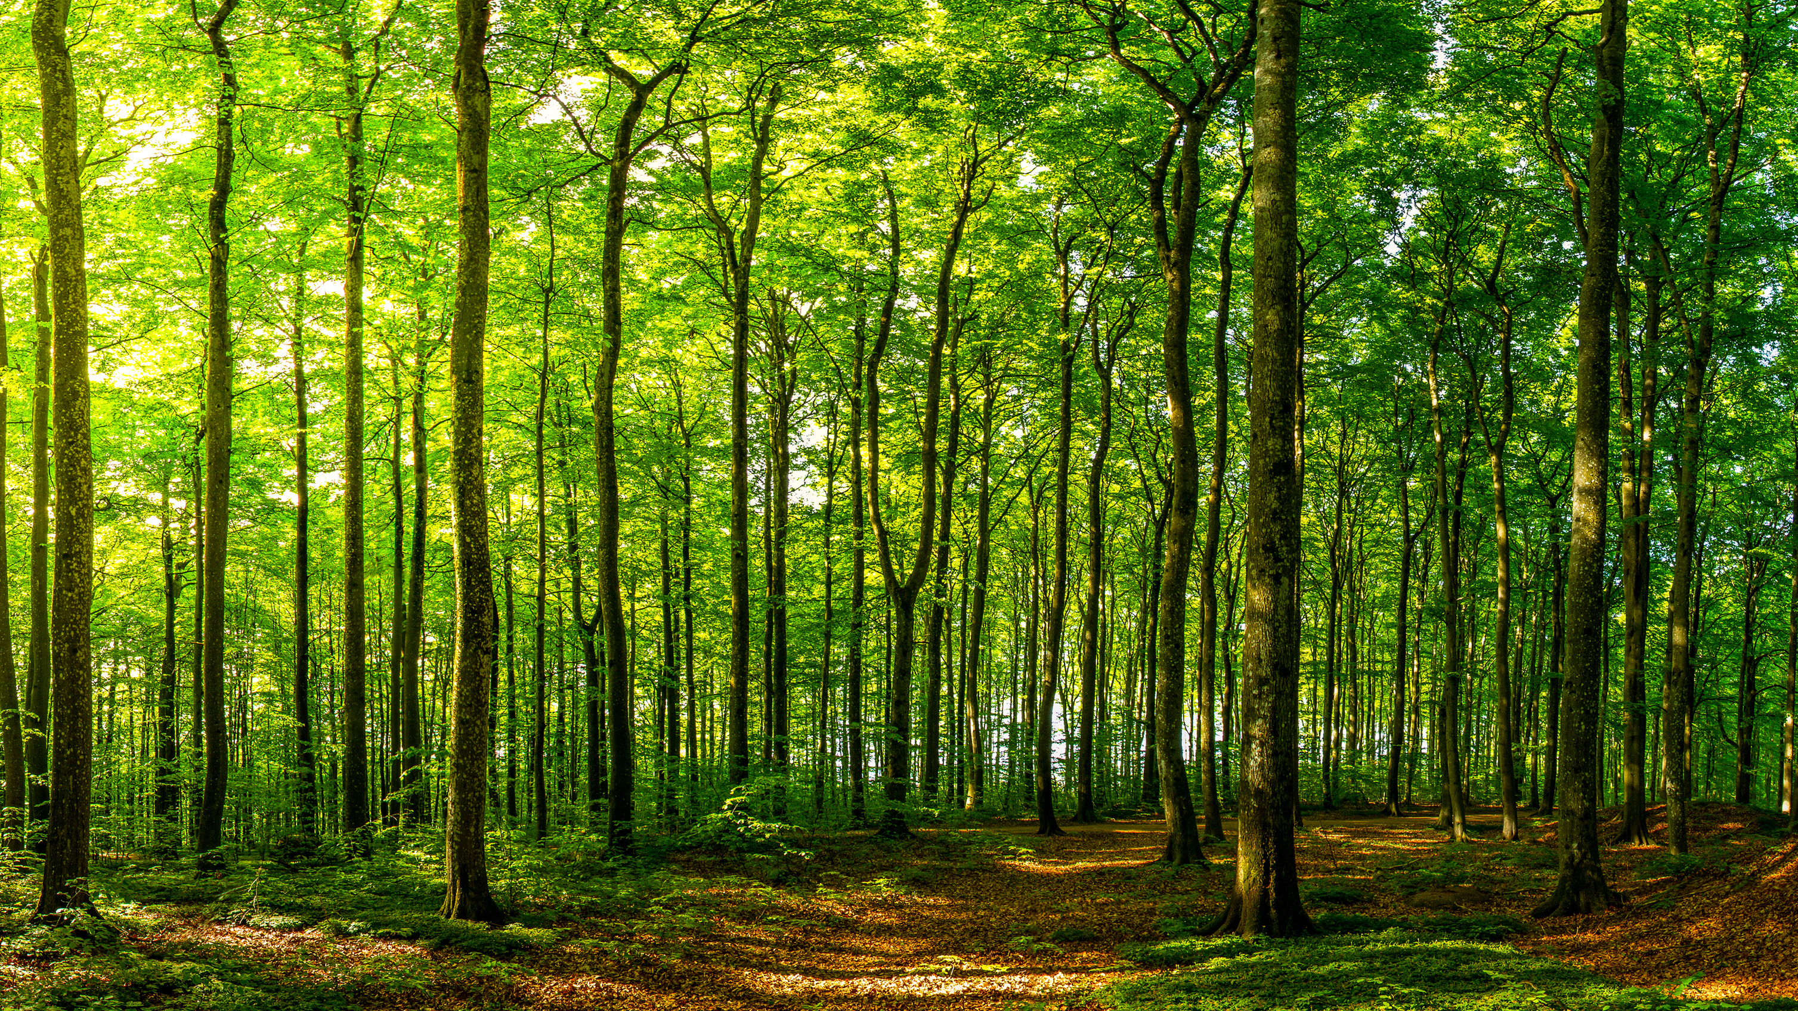
Rural Lifestyle …
The Awendaw Community recognizes and supports the fishing, wildlife, and forest lifestyles including the historic Gullah/Geechee people of the Town as unique and defining attributes.

Slide 9
Rural Lifestyle …

Slide 10
Natural Environment …
The Community seeks to preserve, protect, enhance, and restore the Town’s riparian corridors, woodlands, and wetlands to protect its wildlife and natural habitat, and to maintain its scenic bay vistas and tranquil environment.

Slide 11
Natural Environment …

Slide 12
Built Environment …
The Town believes that the built environment should be subordinate, sensitive, and complementary to the natural environment, setting, and, specific site conditions to minimize disturbance to terrain, conserve visual resources, and protect open space. The Community supports low-country architectural and site design requirements that set forth community expectations and ensure quality development.

Slide 13
Built Environment …

Slide 14
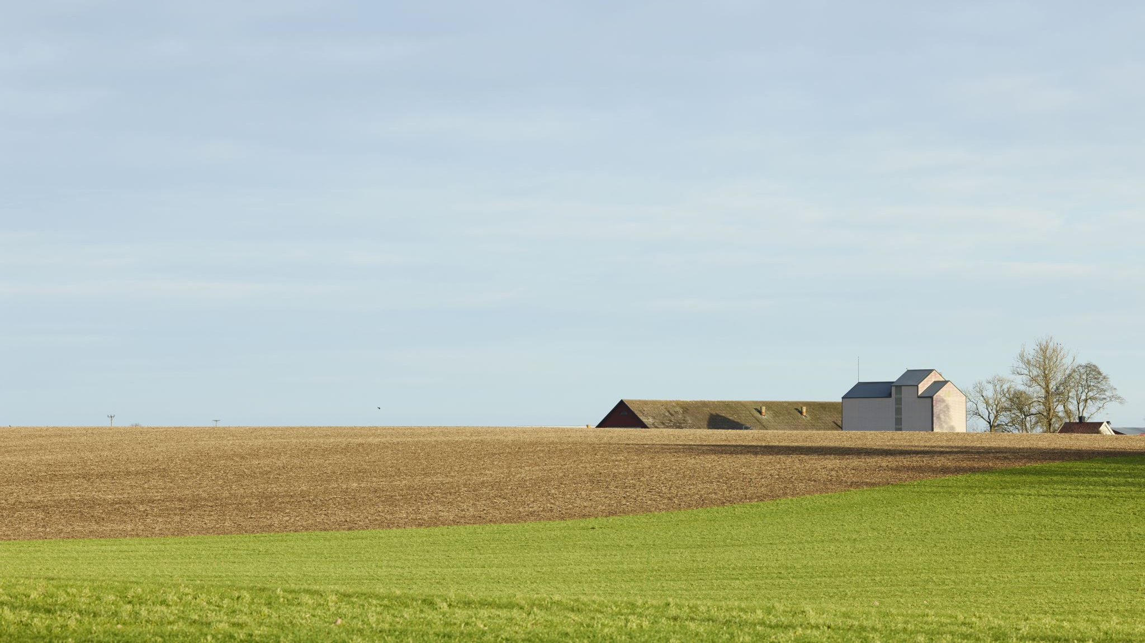
Rural Density …
The Awendaw Community strives to avoid the suburbanization of its Town by limiting rural residential density to a maximum of four units per acre in the densest locations on major roadways and then decreasing sharply as you move toward town peripheries. Planned communities will incorporate considerable open space and natural areas into their designs

Slide 15
Rural Density …

Slide 16
Circulation …
The Awendaw Community promotes safe and convenient circulation for all modes of travel throughout the Town, on Town roads, trails, and paths.

Slide 17
Circulation …

Slide 18
Commercial Services …
The Awendaw Community desires commercial services and facilities which meet the frequently recurring needs of the residents and the occasional needs of highway travelers. The Community feels that a key economic driver for the sustainability of the Town will be eco-tourism and businesses that support this endeavor.

Slide 19
Commercial Services …

Slide 21
Safety …
Awendaw strives to protect persons and property from unreasonable exposure to natural hazards, such as hurricane activity, fire, unstable terrain, storms, and flood, by continuously improving regulations, policies, and procedures to reflect current best management practices.

Slide 22
Safety …

Slide 24
Community Culture …
Awendaw favors a community culture that encourages citizen involvement, individual expression, and diversity, and recognizes the interdependence with neighboring communities and responsibility as good citizens within the region, State, and nation.

Slide 25
Community Culture …

Slide 27
Sustainability …
The Awendaw Community seeks to be a good steward of the land. The goal is to promote the conservation of resources and utilize sustainable practices which recognize the connection to, and interdependence with, the natural environment.

Slide 28
Sustainability …

Slide 31
Agenda Item #3
Open House Assistance by Steering Committee Members and Staff

Slide 32
Agenda Item #4
Planned Development Regulations Update

Slide 33
Agenda Item #5
Awendaw Tree Canopy Report Outcome

Slide 40
Agenda Item #6
Community Survey Ideas

